Slide 1

Get Away Mansion Hotel Management System
This presentation outlines the design and implementation of a database management system (DBMS) for the Getaway Mansion hotel. It details the database schema, normalization, and key functionalities.

Slide 2
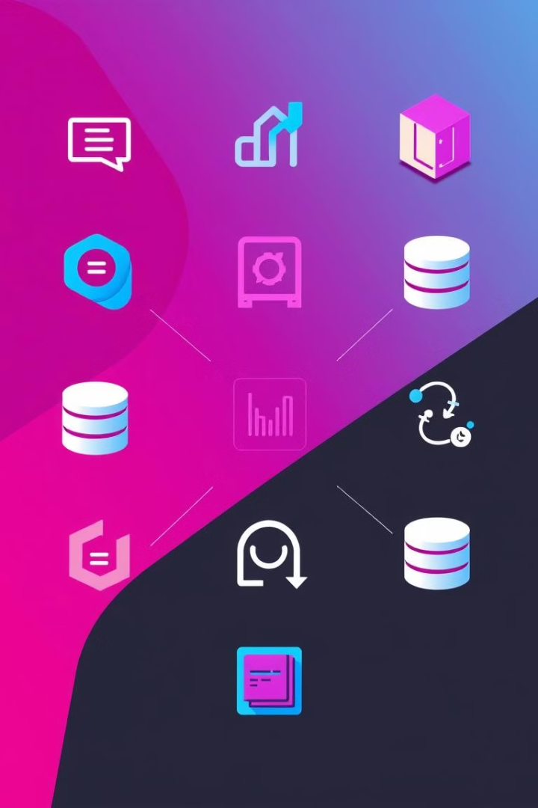
Introduction to Database Management System (DBMS)
1
Data Storage and Retrieval
2
Data Integrity
Ensuring data accuracy and consistency is crucial for effective hotel operations.
A DBMS efficiently stores, organizes, and retrieves large amounts of data.
3
Data Security
4
Data Access and Management
Protecting sensitive information is essential for customer privacy and business continuity.
DBMS facilitates controlled access and management of data by authorized users.

Slide 3
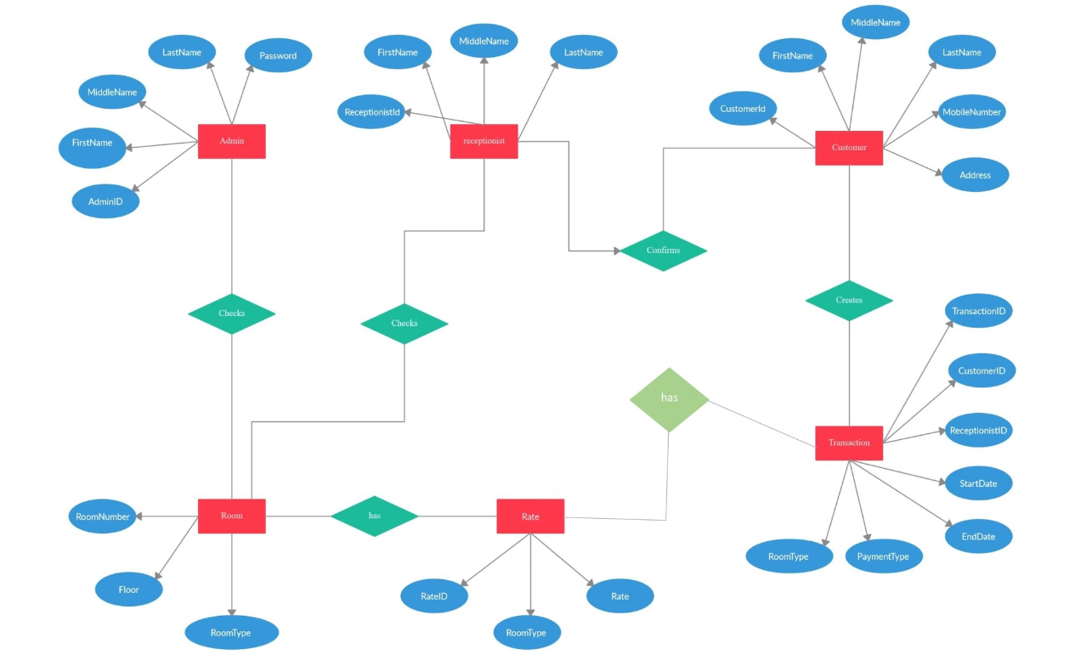
Database Design: Entity Relationship (ER) Diagram

Slide 4

Database Normalization: 3rd Normal Form (3NF)
Eliminate Redundancy
Improve Data Integrity
Normalization removes duplicate data, reducing storage requirements and enhancing data integrity.
Data consistency is maintained, ensuring accuracy and preventing inconsistencies across different tables.
Enhance Query Performance
Normalized databases optimize data retrieval and processing, leading to faster and more efficient queries.

Slide 5

Tables in the Database: Admin, Customer, Receptionist, Room, Rate, Transaction
Table Name
Columns
Admin
AdminID, FirstName, MiddleName, LastName, Password
Customer
CustomerID, FirstName, MiddleName, LastName, Address, Phone
Receptionist
ReceptionistID, FirstName, MiddleName, LastName
Room
RoomNumber, Floor, RoomType
Rate
RateID, RoomType, Rate
Transaction
TransactionID, CustomerID, ReceptionistID, StartDate, EndDate, PaymentType, RoomType

Slide 6


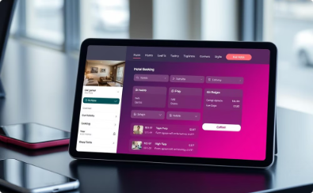
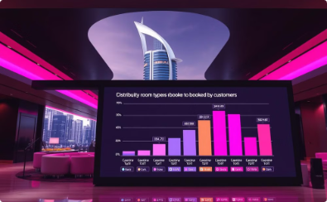
Database Queries and Functionality
Efficient Data Retrieval
Cost Calculation
Retrieving Customer Information
Supporting Complex Queries
For example, the total cost of a reservation is calculated by multiplying the difference between the start and end dates by the rate of the selected room type.
The database management system enables efficient data retrieval and manipulation.
The database system supports complex queries to answer specific questions about the hotel's operations, such as identifying the most popular room types or analyzing customer demographics.
Additionally, the system can retrieve customer information, room details, and booking history.

Slide 7




Database Queries and Functionality
Explore Our Rooms
Browse our selection of rooms tailored to your guest's needs and preferences.
Customer Booking
Record customer information, room details, and check-in/out dates.
Payment Processing
Process payments and generate receipts for customer transactions and store payment type in transaction table. And calculate total amount based on Check In/Out Date.

Slide 8
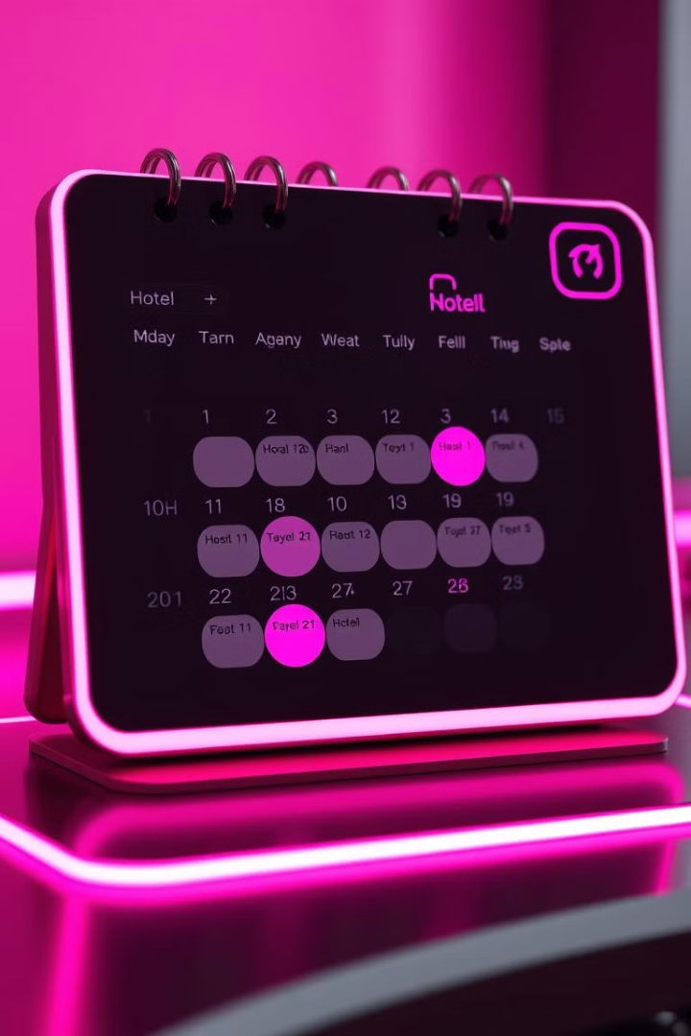
Conclusion and Future Enhancements
This database system offers a robust solution for managing hotel operations effectively and efficiently. It streamlines administrative tasks, enhances data accuracy, and provides valuable insights for informed decision-making. The system's capabilities provide a strong foundation for future enhancements, including online booking integration, and mobile app development, further optimizing the hotel's operations and guest experience.

